Slide 1

Data Analytics for E-commerce: The ISKCON Divine Cart Case Study
Prepared by Prapti Mishra, a Krishna Devotee
Hāré Kr̥ṣṇa Hāré Kr̥ṣṇa, Kr̥ṣṇa Kr̥ṣṇa Hāré Hāré Hāré Rāma Hāré Rāma, Rāma Rāma Hāré Hāré

Slide 2
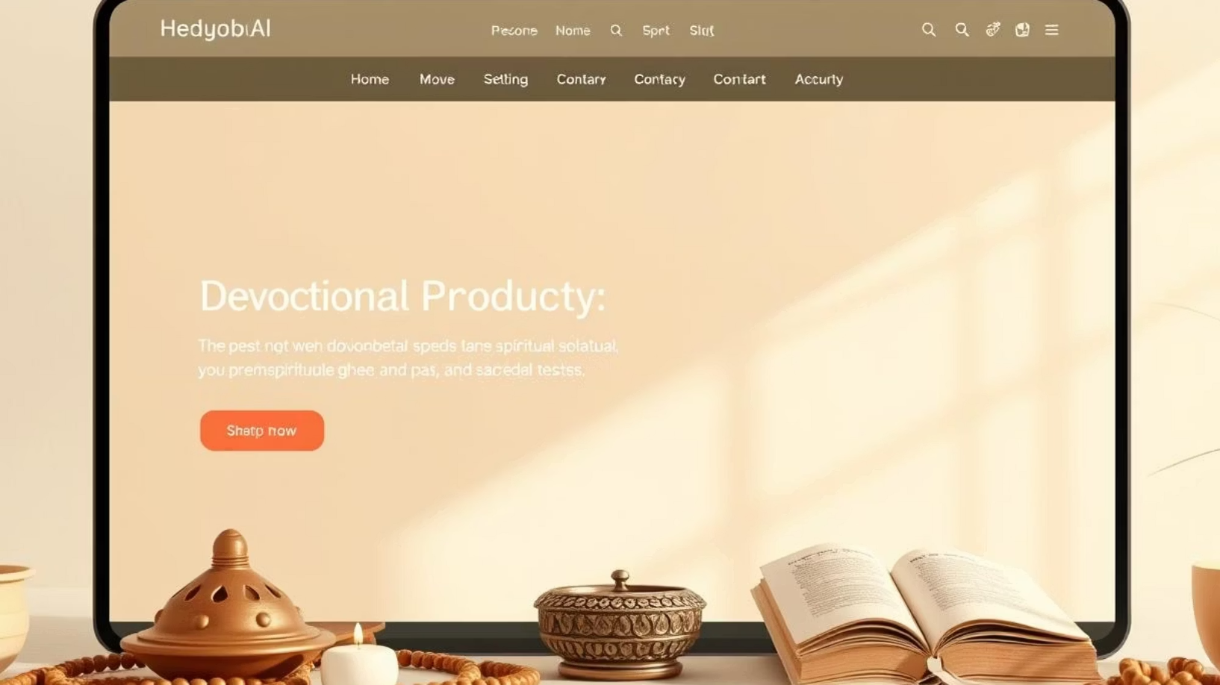
ISKCON Divine Cart: An Overview
ISKCON Divine Cart is a unique e-commerce platform dedicated to offering a wide range of devotional products that support spiritual practices and lifestyle. The platform aims to serve devotees and spiritual seekers worldwide by providing authentic items directly sourced or approved by ISKCON temples.
Accessories: Such as Tulsi malas for chanting and Ghee lamps for traditional aarti ceremonies.
Books: Including essential scriptures like the Srimad Bhagavatam, offering profound spiritual knowledge.
Ritual Supplies: Items like Tilak for sacred markings and various types of incense for offerings.
Mahaprasadam: Sanctified food items, including traditional laddoos and special rice preparations, blessed in temple rituals.

Slide 3







Key Platform Features Enhancing User Experience
User Accounts
Cart Management
Coupon Application
Seamless login and registration for personalized shopping experiences.
Efficient system for adding, reviewing, and managing items before purchase.
Integrates discount codes, enhancing affordability and promotional strategies.
User Recommendations
Daily Specials
Devotional Chatbot
Personalized product suggestions based on browsing and purchase history.
Highlighting new products or limited-time offers to encourage frequent visits.
AI-powered assistant providing spiritual guidance and customer support.
Background Music
Soothing bhajan music for an immersive and devotional shopping atmosphere.

Slide 4

Preparing for Your Data Interview: The Case Study Approach
Imagine yourself in a real-world scenario. An interviewer asks you to apply your data analysis skills to optimize business strategies. Let's delve into the ISKCON Divine Cart case study to prepare for such challenges.

Slide 5
Data Consultant Scenario: ISKCON Divine Cart
As a data consultant for ISKCON Divine Cart, your primary task is to help management optimize product offerings and refine their marketing strategy. You have been granted access to the following critical database tables:
Users
Products
Orders
OrderDetails
Coupons
(user_id)
(product_id)
(order_id)
(order_detail_id)
(coupon_code)
(username)
(name)
(user_id)
(order_id)
(discount_value)
(is_premium)
(price)
(total_amount)
(product_id)
(is_active)
(created_at)
(category)
(coupon_code)
(quantity)
(rating)
(created_at)
(price_per_unit)
These tables provide a comprehensive view of customer behavior, product performance, and transactional data, essential for informed decision-making.

Slide 6

Key Questions for Data Analysis
You are provided with a set of relational database tables that represent the backend of ISKCON Divine Cart, a spiritual and devotional e-commerce platform. Your task is to address a series of critical business questions aimed at guiding ISKCON's strategic decision-making, inventory planning, and customer experience enhancement.

Slide 7
Question 1: Identifying Top 3 Best-Selling Products
The management is keen to understand which products are performing best in terms of sales volume. Your task is to:
Identify the top 3 best-selling products.
Base your analysis on the quantity sold.
Utilize the Products and OrderDetails tables to derive this information.
This insight will help in inventory management, marketing focus, and potentially identifying cross-selling opportunities.

Slide 8

SQL Query for Top 3 Best-Selling Products
SELECT p.name, SUM(od.quantity) AS total_soldFROM OrderDetails odJOIN Products p ON od.product_id = p.product_idGROUP BY p.nameORDER BY total_sold DESCLIMIT 3;
This SQL query efficiently joins the OrderDetails and Products tables. It aggregates the total quantity sold for each product and then orders them in descending order to identify the top performers, limiting the results to the top 3.

Slide 9
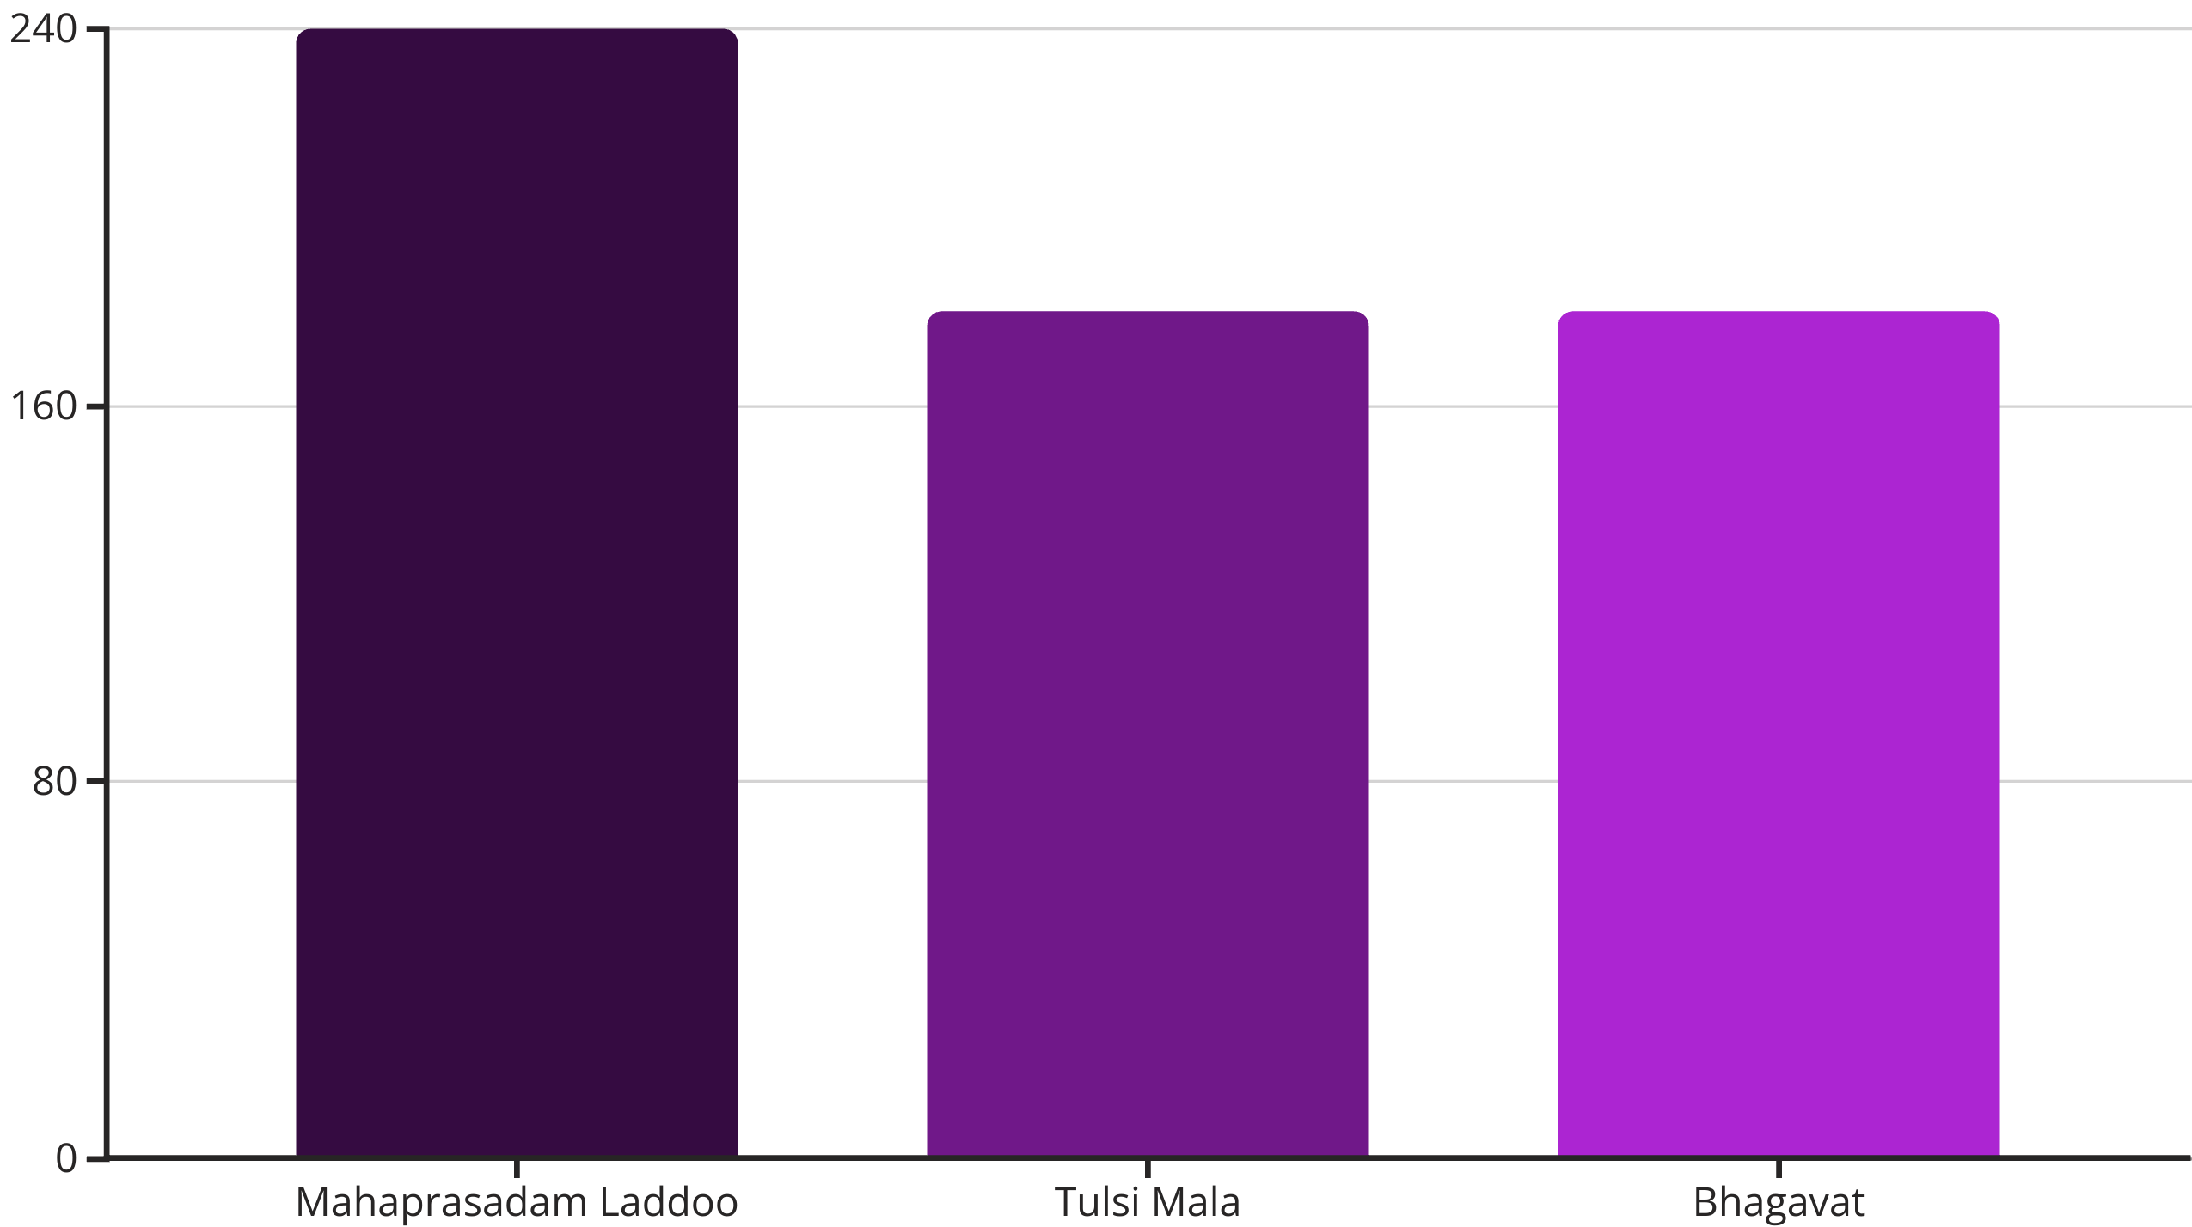
Answer: Top 3 Best-Selling Products
The top three best-selling products are: Mahaprasadam Laddoo (240 units), Tulsi Mala (180 units), and Bhagavat (180 units). These items indicate a strong customer preference for devotional food and essential spiritual accessories. This data suggests focusing marketing efforts on these popular categories and ensuring consistent stock availability.

Slide 10

Question 2: Coupon Code Impact Analysis
To assess the effectiveness of promotional strategies, particularly coupon usage, the management wants to understand the spending habits of different customer segments. Your task is to:
Analyze if users who applied the coupon code HAREKRISHNA spend more on average.
Compare their average spending with users who did not use any coupon codes.
Utilize the Orders and Coupons tables to perform this comparison.
This analysis will provide crucial insights into whether coupon promotions are successfully driving higher overall spending or primarily attracting bargain hunters.

Slide 11
-- Coupon Users
SELECT ROUND(AVG(total_amount), 2) AS avg_coupon_order_value
FROM Orders
WHERE coupon_code = 'HAREKRISHNA';
-- Non-Coupon Users
SELECT ROUND(AVG(total_amount), 2) AS avg_non_coupon_order_value
FROM Orders
WHERE (coupon_code IS NULL OR coupon_code != 'HAREKRISHNA');
Coupon Users have an Average Order Value of Rupees 450 and Non Coupon Users have an Average Order Value of Rupees 310.

Slide 12
Question 3:Hourly Demand Pattern for Mahaprasadam
To improve kitchen operations and resource planning, ISKCON Divine Cart wants to analyze when customers most frequently order Mahaprasadam. Understanding peak demand hours can help optimize food preparation, delivery logistics, and staffing. Your task is to:
Analyze the number of Mahaprasadam items ordered across different hours of the day.
Identify peak hours where the demand is highest.
Utilize the Orders, OrderItems, and Products tables with time functions to extract and group data.
This insight can enhance service efficiency and help maintain prasad freshness during high-demand periods.

Slide 13
SELECT
HOUR(o.order_date) AS order_hour,
SUM(oi.quantity) AS total_mahaprasadam_items
FROM OrderItems oi
JOIN Orders o ON oi.order_id = o.order_id
JOIN Products p ON oi.product_id = p.product_id
WHERE p.category = 'Mahaprasadam'
GROUP BY order_hour
ORDER BY order_hour;
The peak ordering time for Mahaprasadam is around lunch hours, with the highest quantity ordered between 11 AM to 1 PM. Early morning and late evening hours show relatively low demand, indicating focused consumption windows.

Slide 14
Question 4:Identification of Unsold Products
The management wants to identify products that have never been purchased by any user. This could indicate lack of visibility, pricing issues, or low relevance. Your task is to:
List all products that have never been included in any customer order.
Use a LEFT JOIN between the Products and OrderItems tables to detect products with no matching order records.
Ensure that the output includes product name and ID for action.
This insight will help in refining the product catalog, running targeted promotions, or retiring irrelevant SKUs.

Slide 15
SELECT
p.product_id,
p.name
FROM Products p
LEFT JOIN OrderItems oi ON p.product_id = oi.product_id
WHERE oi.order_item_id IS NULL;
A total of 3 products have never been sold, including items like Sandalwood Incense, Copper Kalash, and Devotional Wristband. These items may need better promotion, bundling, or removal due to lack of interest.

Slide 16
THANK YOU

